Slide 1
F2 Induction

Slide 2
Differences between F1 and F2
More clinical responsibility and decision-making skills
Responsibility for more clinical procedures e.g. DNACPR, consent forms etc
Responsibility for managing F1s
Preparing for next stage of training
Study leave

Slide 3
F2 – changes for this year
Derogated ARCP requirements ended
30Hrs core + 30hrs non core learning – 60Hrs in the year
New curriculum 2021
New Higher Level Outcomes and Foundation Professional Capabilities
Parity of physical and mental health
Hierarchy of evidence
Capabilities of CPR management still required (ALS not mandatory)
No minimum number of SLEs
Placement Supervision Group mandatory (replaces 1 TAB)
Summary Narratives
Notes:
New Curriculum discussed over the next few slides

Slide 4
Requirements for F2 ARCP
TURAS e-portfolio is platform for recording
All following information is available on the Scottish Foundation School Website

Slide 5
2021 Foundation Programme Curriculum
Notes:
This year sees the launch of the new 2021 Foundation Programme Curriculum. Any trainee moving from F1 to F2 moves to New Curriculum. If already an F2, remain on old curriculum for the remainder of Foundation Training.

Slide 6
Curriculum
al capabilities
THE CLINICIAN
HLO1: THE CLINICIAN
THE HEALTHCARE WORKER
HLO2: THE HEALTHCARE WORKER
HLO3: THE PROFESSIONAL
Direct and indirect patient care:
Clinical Assessment
Clinical Prioritisation
Holistic Planning
Communication and Care
Continuity of Care
Integrating into the healthcare workforce:
Sharing the Vision
Fitness to Practise
Upholding Values
Quality Improvement
Teaching the Teacher
Professional requirements and expectations:
Ethics and Law
Continuing Professional Development
Understanding Medicine
Each FPC further explained in the curriculum
Notes:
Each professional capability (FPC) is further expanded on in the curriculum. There are also a list of behaviours for the FPCs that differentiate the level expected of F1 and F2.

Slide 7
Curriculum
There is a focus on:
Physical health
Mental health
Social health
Across a variety of different areas:
Community or primary care
Acute and chronic hospital environments
Mental health settings and
Environments that provide health promotion
Acute care (including acute mental health care) The management of chronic illness Community care (including population health)
Physical health
Mental health
Social health
Notes:
The New Curriculum has more emphasis on mental health – with significant evidence of mental health learning required.
Focus on learning in community / primary care / chronic settings. Not just acute hospital care.

Slide 8
Curriculum
Requires an equity of mental and physical health evidence
For clinical FPCs - provide SLEs that demonstrate both physical and mental health
Eg FPC2 - management of the acutely unwell patient
Physical health - SLE covering acute cardiovascular deterioration
Mental health - SLE covering delirium or acute confusional state
For FPCs 1-5 it is expected that more than 1 SLE will be required to demonstrate competence.
Both physical and mental health should be underpinned with reflections and learning logs

Slide 9
Curriculum coverage
Curriculum part of e-portfolio on TURAS
3 Higher Level Outcomes (HLOs)
13 Foundation Professional Capabilities (FPCs)
Evidence linked to FPCs
Use range from Hierarchy of Evidence
Millers pyramid – Hierarchy of Evidence
Experiential (SLEs)
Does
(observation)
Shows how
(demonstration of skills)
Simulation
Knows how
(application of knowledge)
Learning / reflection
Knows
(knowledge)
Notes:
TABs & PSG can also evidence parts of curriculum

Slide 10
Curriculum
Notes:
A view of the 1st Higher Level Outcome (HLO) and its corresponding Foundation Professional Capabilities (FPCs). Curriculum linkage will be directly to the FPCs. Next slide shows “view guidelines” button use.

Slide 11
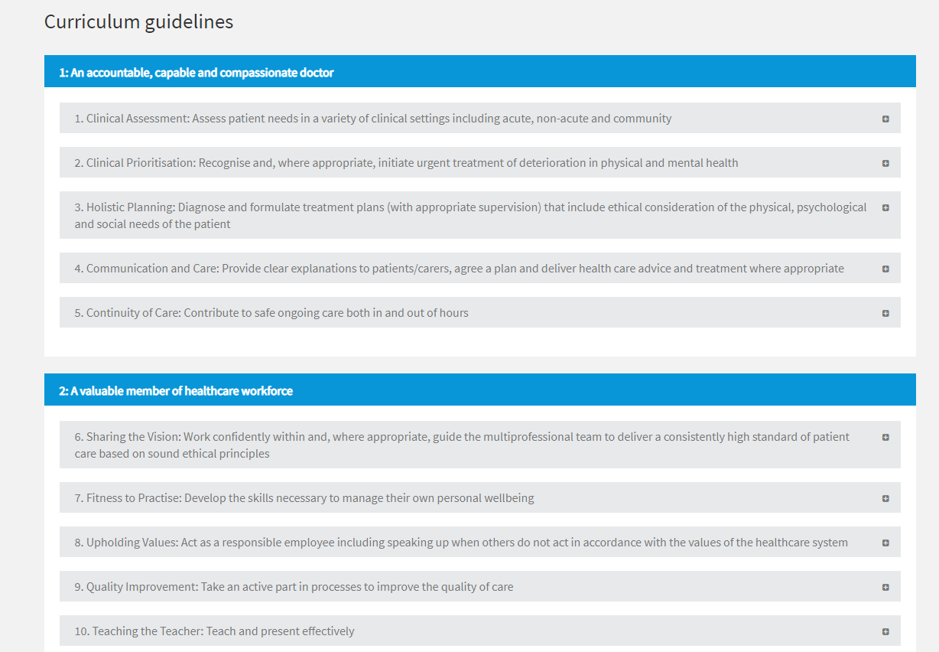
Notes:
Each FPC can be expanded using the plus symbol to the right. This will show the behaviours relevant to either F1 or F2 for that capability. You will now link directly to the FPC, not the behaviours.

Slide 12
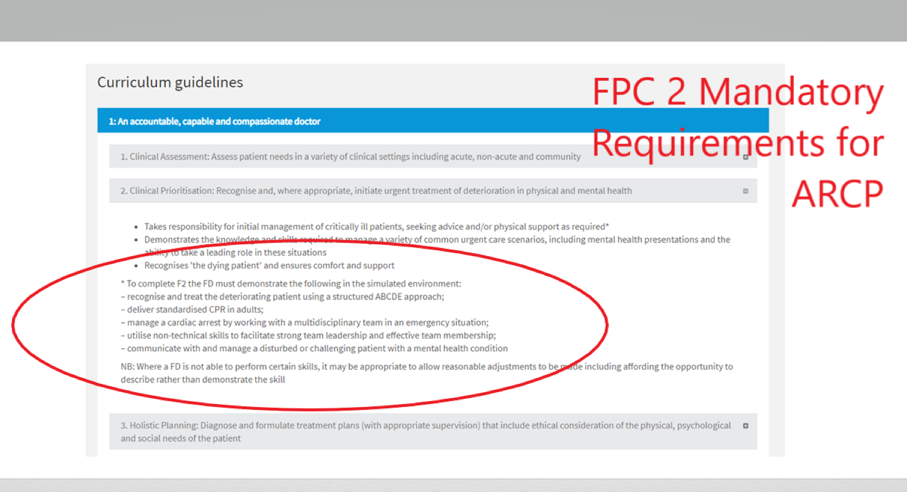
Notes:
These are examples of behaviours that the FD may exhibit that would show evidence of the required capability. Note that FPC 2 has mandatory requirements that must be demonstrated. These are circled in this slide.

Slide 13
Supervised Learning Events
Mini CEX, DOPs, CBD, DCT
A couple of new ones -
LEARN – Learning encounter and reflection note – can use in place of CEX, DOPs, CBD and other forms of evidence eg performance in simulation
LEADER – record feedback of event where demonstrated leadership skills

Slide 14
Supervised Learning Events
No minimum number required
Curriculum states “sufficient” evidence needs to be provided for FPCs
Also states
Evidence to satisfy FPC1-5 should include direct observation of at least 5 clinical encounters (SLEs) and specific life support capabilities in FPC2.
Hierarchy of evidence – SLEs best (does)
A range of evidence expected for FPCs
FPC2 must be evidenced with capabilities demonstrated
SLEs are great way to learn, done in workplace – not your free time!
Notes:
No minimum number of SLEs required – but these are the best forms of evidence, great way of learning and done at work.

Slide 15
Placement Supervision Group (PSG)
Feedback from senior healthcare professionals
Clinical and professional practice
Form generated by supervisor at initial meeting
Supervisor will send tickets at appropriate time to group members
Informs supervisor’s end of placement report
Good opportunity to show excellence in your training
1 satisfactory PSG per year mandatory (post 1 or 2)
Notes:
Mandatory for the New Curriculum this year.

Slide 16
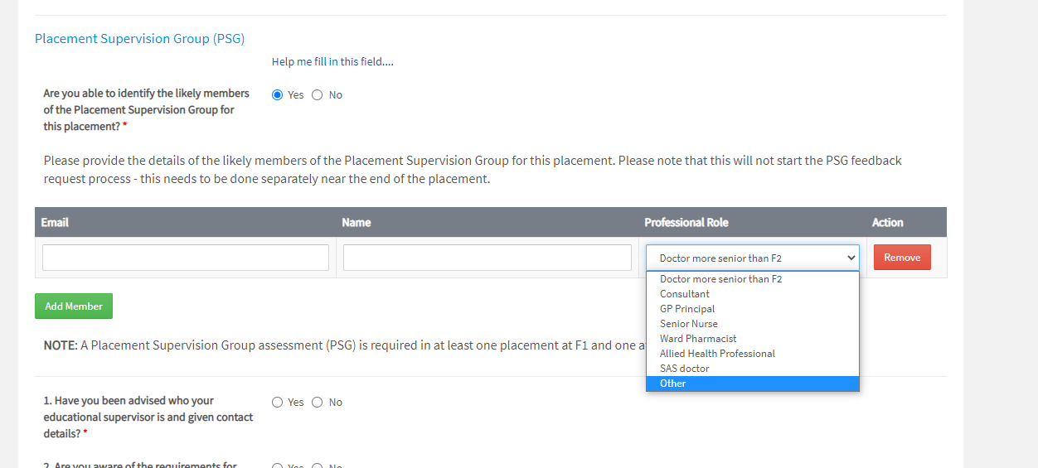
Placement Supervision Group
Notes:
Screenshot from Initial Meeting form. Members of PSG identified and added. This can be edited by supervisor when generating tickets.

Slide 17
Summary Narrative
One for each HLO over the year – 3 in total
Up to 300 words each
Reflect on progress with curriculum evidencing
Explain the rationale for evidence selected to demonstrate each HLO
Start process of self development, train for appraisal & revalidation
Formative assessment
Notes:
Start writing in your first post and add to in subsequent posts. Similar to what career grades do for appraisal. Allows you to explain why you have selected certain bits of evidence to demonstrate curriculum coverage – and think about what you need to do in subsequent posts. Supervisor should review in each post, rate and give advice.

Slide 18
Study leave
This includes deanery teaching, tasters & simulation
ALS no longer mandatory – any SL budget if not doing ALS TBC
Up to 8 days available for SL
Must have service approval prior to requesting leave
Must be requested on TURAS PRIOR TO DATE OF LEAVE otherwise cannot be authorised
Please request tasters in the same manner as other SL

Slide 19
Study Leave
Included
Day to sit professional exam
Excluded
Exam preparation courses
Interviews (service leave)
Interview practice courses

Slide 20
Tasters
Opportunity for exposure to help guide career choices
Up to 2 specialties
Max of 5 days each
Within region in almost all circumstances
Not overseas
Request in the same way as SL requests on TURAS system

Slide 21
Core & Non Core Learning
Core (30 hours)
Delivered education programme
Simulation sessions
Learning mapped to missed topics
Non Core (30 hours)
Dept teaching / meetings / grand rounds / M&Ms / journal clubs etc
Not experiential / “on the job” learning
Not tasters
All recorded in portfolio by trainee

Slide 22
Reminder of Requirements
3 combined supervisors EoPR
TAB
PSG
PSA
Core & non core learning
QI project
Curriculum evidenced
Incl FPC2 specific cardiopulmonary arrest management
Summary narratives
Engagement with programme

Slide 23
Reminder of Other Requirements
SOAR declaration
Absence declaration
Completion of Destination Survey – end F2
GMC National Trainee Survey (NTS) April/May
Scottish Trainee Survey (STS) (at end of each post)

Slide 24
Further Information
UKFPO website
https://foundationprogramme.nhs.uk/curriculum/new-uk-foundation-programme-curriculum-2021/
Scottish Foundation School Website
https://www.scotlanddeanery.nhs.scot/trainee-information/scottish-foundation-school/current-trainees/

